Slide 1



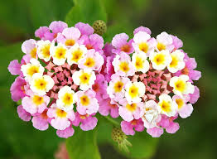
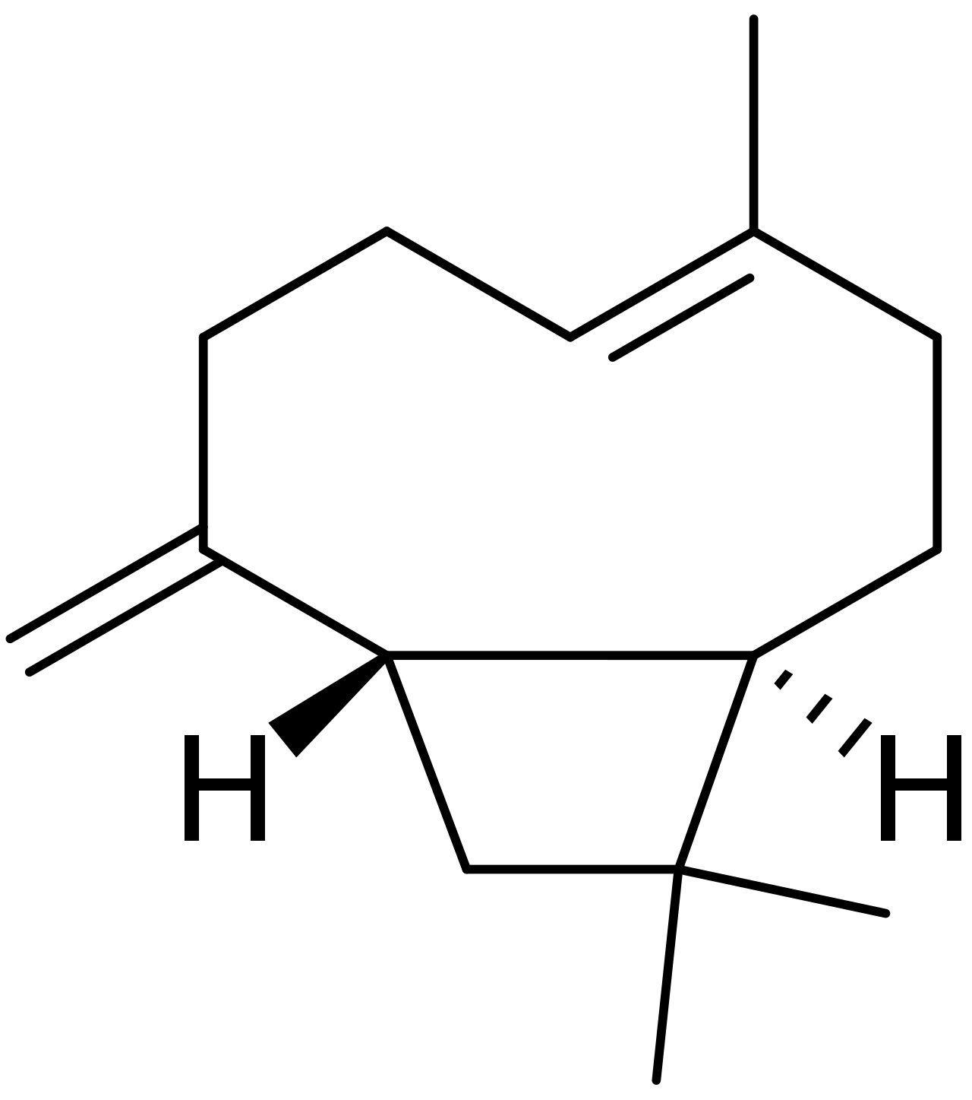
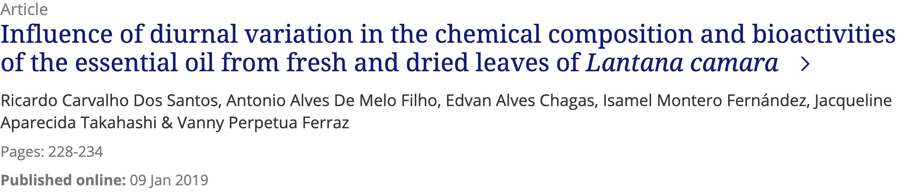


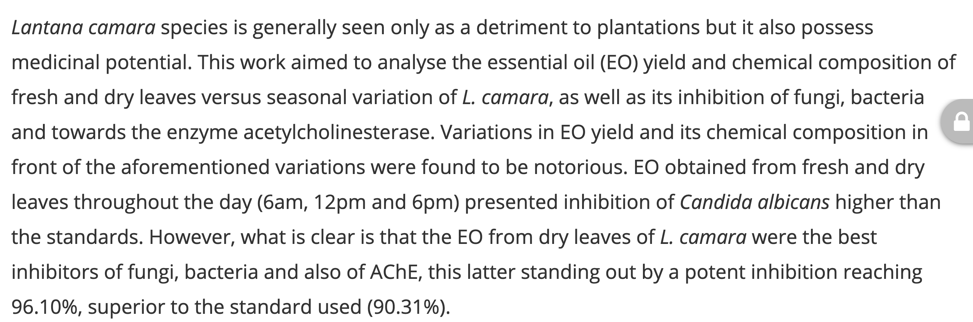

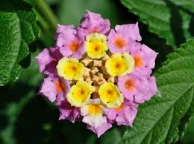
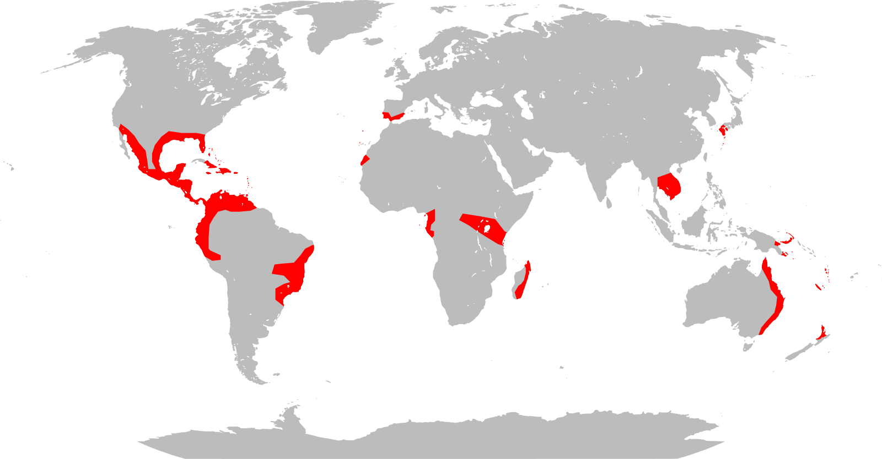
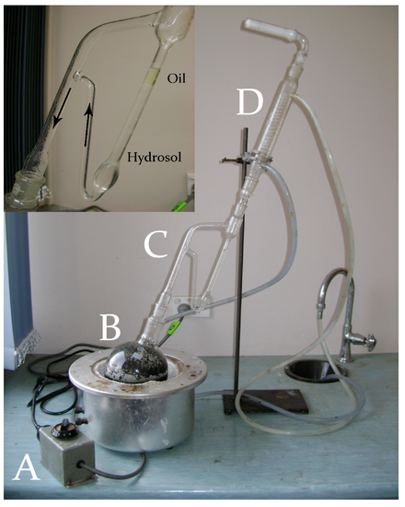
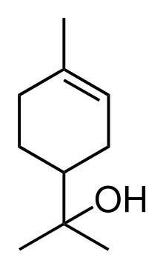
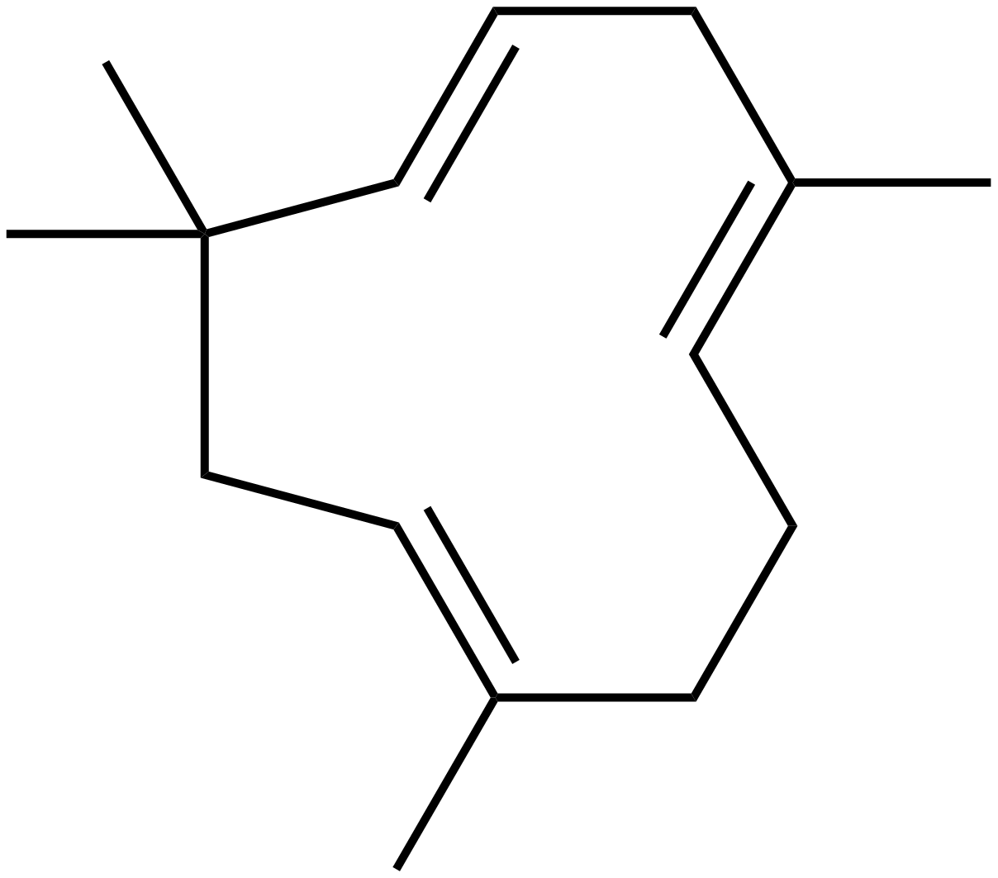
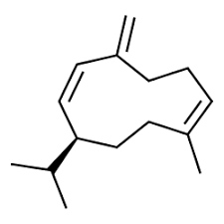

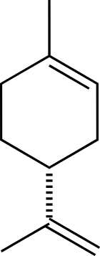
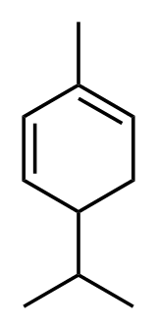
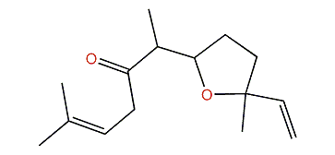
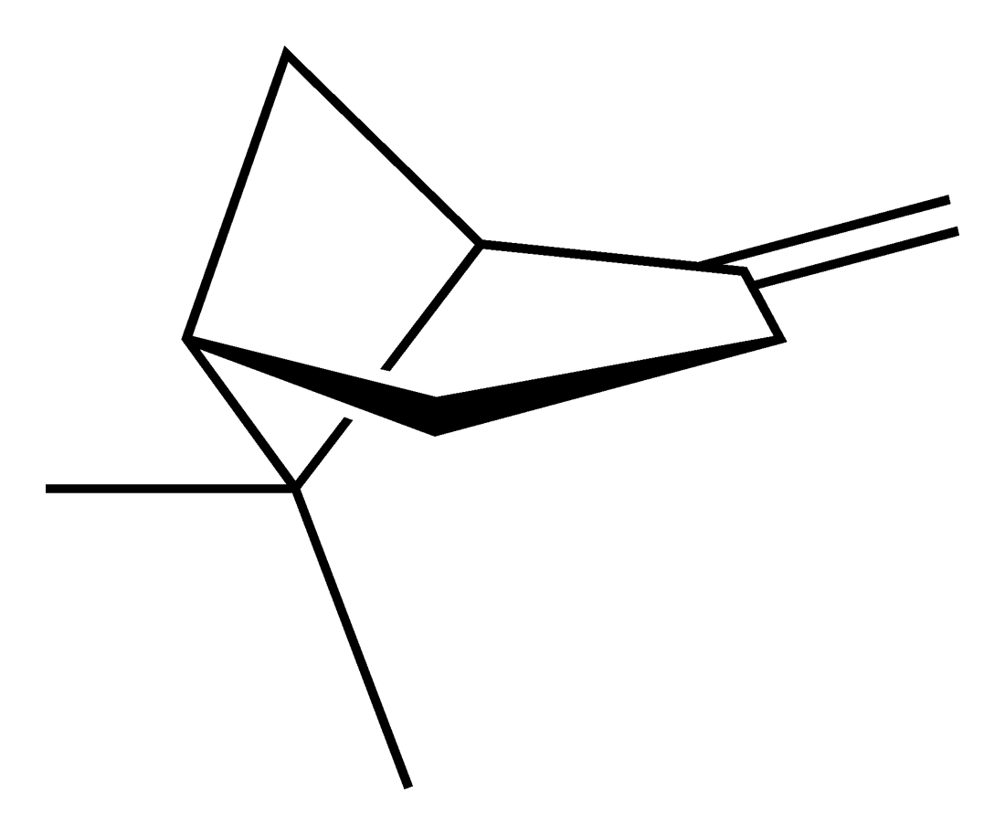
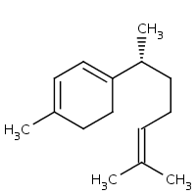
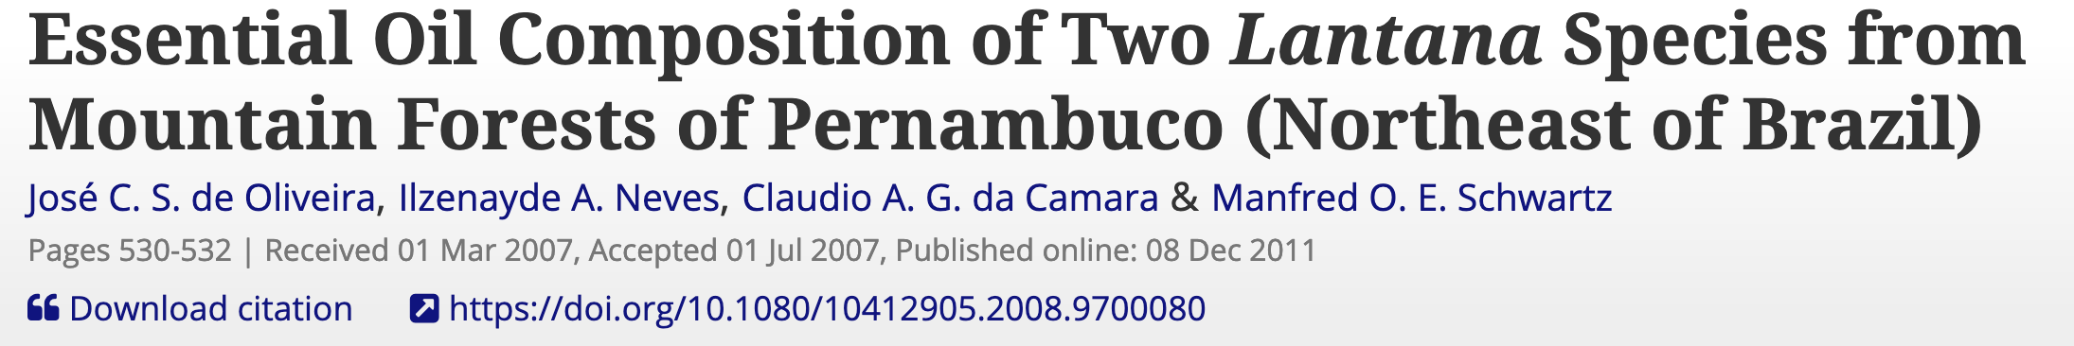
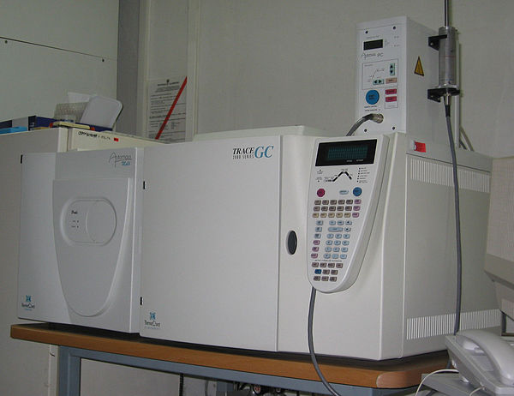
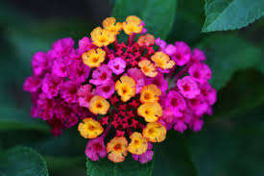
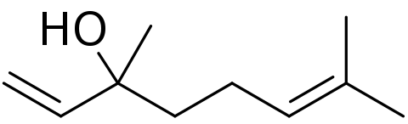
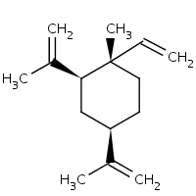
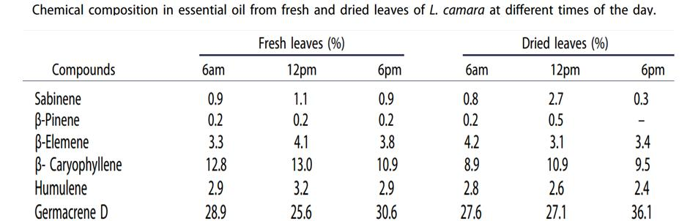
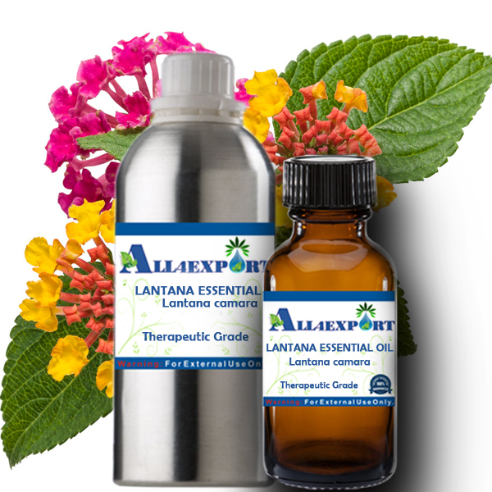
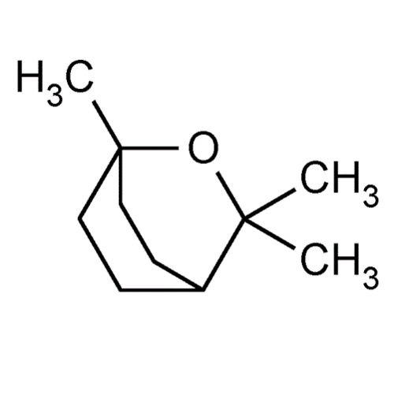
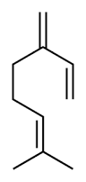
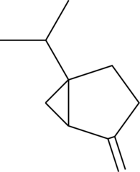
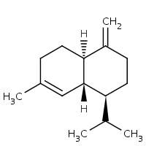
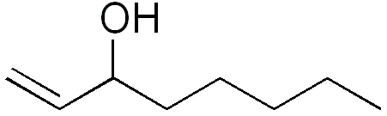
EssoilDB: A semantic phytochemical knowledgebase
Vinita Lamba¹, Shruthi M¹, Manish Kumar¹, Ambarish Kumar¹, Gitanjali Yadav^{1,2}, Peter Murray-Rust^{2,3, a}
¹ National Institute of Plant Genome Research, New Delhi, IN; ² University of Cambridge, UK; ³ ContentMine Ltd, Cambridge, UK
OVERVIEW. Plants are capable of generating a diverse spectrum of volatile organic compounds for maintaining communication and fruitful adaptive interaction with their environment. These are proven to be important protective and signalling molecules & constitute a platform for plant–plant interaction. For 13 years, EssoilDB in NIPGR, has captured the plant literature on terpenes (class of phytochemicals).
BACKGROUND: In 2019-02 [1] GY, VL, AK collaborated with ContentMine/PMR to run a TIGR²ESS workshop on mining the plant literature. We deployed Open text-mining tools (ContentMine’s getpapers,AMI) and used Wikipedia/Wikidata to create WikiFactMine dictionaries (e.g. pests, microorganisms, soiltypes, invasive species, spices…) and showed that Open semantic text-mining was robust and could be deployed in many areas of Plant Science.
Q332469
Q421614
SEMANTICS: Wikidata (a Wikimedia project) has over 50 million items of Open semantic knowledge. Items have unique identifiers (Q numbers) related by properties (P). Example: “ the invasive species Lantana camara produces beta-caryophyllene” is represented by the triples: Q332469 P5626 “56” (L. camara hasGISDId 56 – (GlobalInvasiveSpeciesDatabase))
Q421614 P1582 Q332469 (beta-caryophyllene isNaturalProductOf L. camara)
The new EssoilDB 2.0
We use EssoilDB2.0 to support text-mining … … and text-mining to populate EssoilDB2.0!
ingestion + annotation of current articles
EssoilDB table
EssoilDB 2.0
Bibliography (1600)
dictionary
Check semantics
Independent
variables
Crossref Unpaywall
disambiguate
location (500)
Profile
extraction
https://doi.org/10.1080/10412905.2018.1555102
bibliography
Q638949
Compounds emitted in single experiment
measurement
plant
Journal of Essential Oil Research (Q15039440)
agriculture
normalize
plant (1860)
compound (7500)
plantpart
terpene
microorganism
GBIF
Pubchem OPSIN
plantpart
Wikifactmine Dictionaries (20+)
Easily created by dataminers from selected Wikipedia/Wikidata entries, such as
crop
funder
governmentAgency
habitat
invasiveSpecies
organism
pest
pollinator
soil type
virus
mono-, di-, triterpene
Q20011319
date-time
ISO8601
nonplant species
populate
conditions
Dataminer selects Wikipedia
Category or Page and ami-dictionary creates
WikiFactMine dictionary
enzyme
datetime
[dictionaries]
EssoilDB 1.0
Syntax, spelling, semantics, disambiguate, link
Table(count)
key
Open lookup/disambiguation
Knowledge Components in EssoilDB 2.0 (illustrated by L. camara)
Global distribution of L. camara (Wikimedia)
steam distillation (Q1164392)
Plantpart [Q20011319)]
Q421614
Q27109437
Clevger Apparatus Hydrodistillation ^{[1]}
β-caryophyllene
Q27121615
Q27121451
Q278809
α-humulene
germacrene D
leaf Q33971
α-terpineol
Q58896121
location
extraction
Q25933668
limonene
Compound
[Q11173]
(7000+)
davanone
α-phellandrene
γ-curcumene
GC-MS (Q873009)
Q300928
β-pinene
β-elemene
Q27132733
Q40942
bibliography
linalool
fruit Q1364
1,8-cineole
myrcene
1-octen-3-ol
γ-cadinene
Q410932
sabinene
Q27132237
Profile
measurement
flower Q506
Q28138856
Q424577
Q161667
Q27132466
Common plant-parts Lantana
Compound Q11173
Q421278
Queries that EssoilDB2.0/Wikidata can support
Do invasive species produce sesquiterpene toxins?
Can chemical fingerprints be identified for invasives across habitats?
Who funds, or is likely to fund terpene research?
What new phytochemicals have been reported in 2019 preprints?
Identify plants that produce chemicals similar to known medicinal drugs.
References and Acknowledgements
TIGR2ESS workshop : https://tigr2ess.globalfood.cam.ac.uk/news/adventures-r-reflections-tigr2ess-workshop-r-genomics-and-data-mining
ContentMine.org software: http://github.com/contentmine and : http://github.com/petermr/normami
https://www.wikidata.org/wiki/Wikidata:WikiFactMine
http://www.all4export.com/index.php?route=product/product&product_id=411
Images from Wikimedia Commons; Licence CC0 and CC BY-SA
GY, VL, AK, MK thank NIPGR for financial support.
GY Thanks the DBT-Cambridge program for Funding (University of Cambridge, Dept of Biotechnology, Govt of India)
a: (PMR’s IDs) [Wikidata] : [Q908710] (ORCID) (0000-0003-3386-3972)
Notes:
=.

